Slide 1

Electromagnetic Study on Earthquakes and Volcanoes (EMSEV 2018) International Workshop, September 17 - 21, 2018, Potenza, Italy.
Integrating Geophysical Observations from Ground to Space for Earthquake and Volcano Investigations
Model for generation of geomagnetic perturbation in the ionosphere due to tsunami
V.M. Sorokin, A.K. Yaschenko, V.V. Surkov
Puskov Institute of Terrestrial Magnetism, Ionosphere and Radio Wave Propagation (IZMIRAN), Russian Academy of Sciences, Troitsk, Moscow, 108840, RUSSIA.
The mechanism for geomagnetic field perturbation associated with tsunami wave propagation is considered. The source of perturbation is assumed to be electric currents in the sea medium and the ionosphere. Electric current in the sea medium is due to the tsunami-produced wave motion of the seawater in the geomagnetic field while the ionospheric current is due to acoustic-gravity wave (AGW) propagating from the atmosphere into the ionosphere.

Slide 2
Example of experimental results
H. Sugioka et al., Scientific reports, 2014
Tsunami wave fronts associated with the Chilean earthquake (06:34 on 27 February, 2010) inferred from arrival times at the seafloor magnetometer array network.
White lines and white arrows show the estimated positions of the tsunami wave front and the tsunami propagation vectors, respectively. Red arrows show the propagation vectors inferred from the electromagnetic data.
Observed vertical magnetic field perturbations (black) and sea bottom pressures (red) induced by the tsunami at a depth of 4800 m at Site 8 of the seafloor array network.
The magnetic field perturbation and the seafloor pressure change associated with the tsunami were 0.5 nT and 1200 Pa respectively.

Slide 3
Tsunami-induced magnetic fields detected at Chichijima Island before the arrival of the 2011 Tohoku earthquake tsunami.
Tatehata et al. Earth, Planets and Space, 2015.
Magnetic field observations at a Kanoya (KNY) and b Chichijima (CBI). The blue line is the horizontal component H and the red line is the vertical component Z. The red arrow indicates the arrival of the anomalous signal associated with the tsunami
Tide gauge record and b Z record observed at Chichijima Island on 11 March 2011 (UTC). Triangles indicate the arrivals of the tsunami and the magnetic signal; peaks are indicated by small circles

Slide 4
Electromagnetic field equations.
Ohm's law in the sea:
in the ionosphere:
Since the skin layer in the both sea and ionosphere is much greater than their transversal scale one can replace field equations by the relevant boundary conditions at the two layers with integral conductivities.

Slide 5
Schema of electric current in our model.
The AGW radiates into the atmosphere due to vertical displacements of seawater surface during tsunami wave propagation. Although the ionospheric conductivity is much smaller than seawater conductivity, the current in the ionosphere can be greater than that in the seawater due to an exponential increase in the amplitude of the upward propagating AGW.
1. Conducting layer of the low ionosphere; 2. Conducting layer of the conjugate ionosphere; 3. Sea layer; 4. Tsunami wave; 5. Acoustic-gravity wave; 6. Electric current in the sea layer; 7. Ionospheric perturbation; 8. Field-aligned current in the upper ionosphere and in the magnetosphere; 9. Electric current in the ionosphere and conjugate ionosphere; 10. Satellite trajectory.
Notes:
5

Slide 6
Components of magnetic field perturbation in the atmosphere.
We use following notations:
Where v_{x} is the horizontal speed of ionospheric plasma in AGW;
V_{x} is the horizontal speed of sea water in tsunami wave.
Connection of component speed of sea water in tsunami wave and vertical displacement of the sea surface.

Slide 7
AGW generation
Equation for gas speed in AGW.
Solution of equation.
Calculation of spatial distribution of gas speed in AGW.

Slide 8
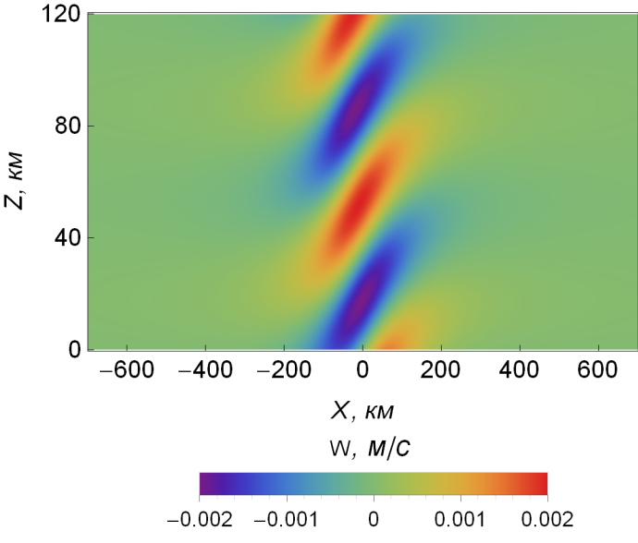
Calculation result of spatial distribution of function W(x,z) in the vertical plane of atmosphere.
Function

Slide 9
Calculation of magnetic field perturbation.
Vertical displacement of sea surface.
We choose following parameters for calculation:

Slide 10
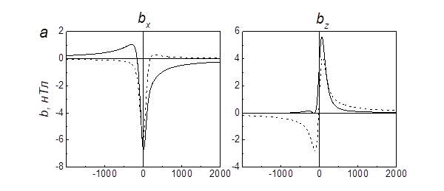
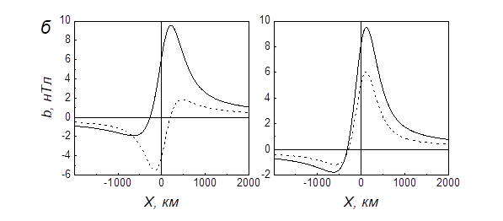
Calculation result of horizontal distribution of magnetic field perturbation on the sea surface.
Dotted line – magnetic field of electric current in the sea only.
Solid line – magnetic field of electric currents in the sea and in the ionosphere.
Upper panel: scale of the tsunami – 100 km; depths of the sea – 1 km.
Low panel: Scale of the tsunami – 300 km; Depths of the sea – 3 km.

Slide 11
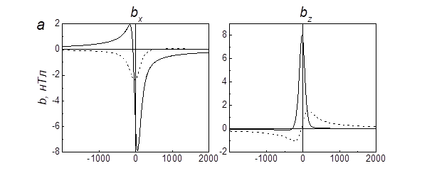
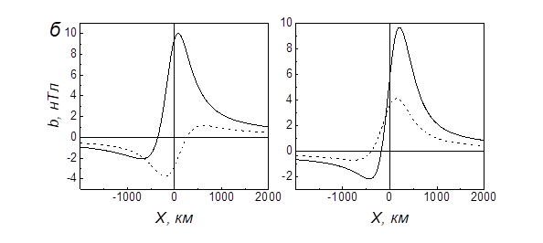
Calculation result of horizontal distribution of magnetic field perturbation in the ionosphere at altitude 120 km.
Dotted line – magnetic field of electric current in the sea only.
Solid line – magnetic field of electric currents in the sea and in the ionosphere.
Upper panel: scale of the tsunami – 100 km; depths of the sea – 1 km.
Low panel: Scale of the tsunami – 300 km; Depths of the sea – 3 km.

Slide 12
Calculation results of spatial distribution of magnetic field horizontal component in the vertical plane of Earth – ionosphere layer.
Upper panel - magnetic field of electric current in the sea layer only.
Low panel - magnetic field of electric currents in the sea layer and in the ionosphere.
Scale of the tsunami – 300 km; Depths of the sea – 3 km.

Slide 13
Field-align current and magnetic field perturbation in the upper ionosphere and magnetosphere generated by tsunami wave
Increase of sea depth results in growth of the horizontal scale of field-align current and magnetic field.
The amplitude can reach values:

Slide 14
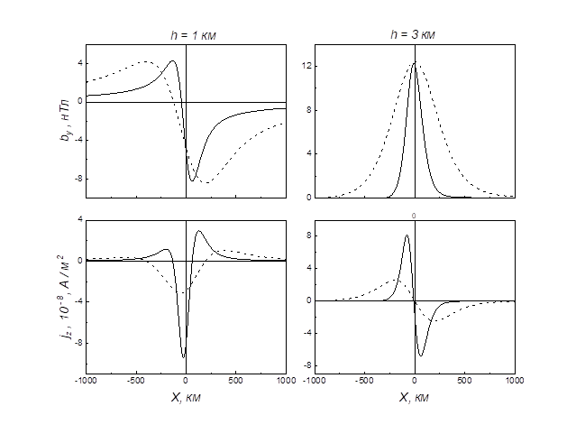
Calculation result of dependence on x of magnetic field component and field-align current in the upper ionosphere and magnetosphere.
Left panel – depth of the sea 1 km; Right panel – depth of the sea 3 km. Solid line – tsunami scale 100 km; Dotted line – tsunami scale 300 km.

Slide 15

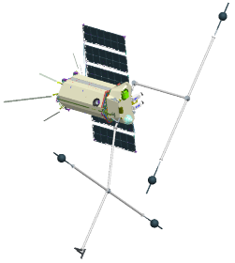
Satellite crosses field-align current above tsunami region. Field-align current caused by interaction of acoustic-gravity waves and ionosphere. Transverse magnetic and electric field is observed.
Field-align current
10⁻⁸ A/m²
Magnetic field
10 nT
Electric field
10 mV/m

Slide 16
Conclusion.
Experimental data and modeling show that the tsunami propagation is accompanied of magnetic field perturbation.
Displacement of sea surface in the tsunami wave is (0.1 – 1) m and magnetic field can reach a value up to 1 nT on the sea.
Currently models are based on assumption that the source of magnetic field is electric current flowing in the sea.
Our model is based on assumption that the source of tsunami magnetic field is electric current flowing both in the sea and in the ionosphere.
Ionospheric electric current caused by AGW propagation in the ionosphere.
Displacement of the sea surface in tsunami wave generates AGW which is propagated upward to the ionosphere.
Ionospheric current closed up through the conjugate ionosphere by field-align current, which excites the transversal component of magnetic and electric field at altitudes of the upper ionosphere and magnetosphere.
The amplitude of magnetic and electric fields as well as the field-align current in the ionosphere can reach values of the order of 10 nT, 10 mV/m and 10⁻⁸ A/m², correspondingly.
We can conclude that these estimates have shown a possibility for monitoring of tsunami wave by electromagnetic satellite techniques.

